Slide 1
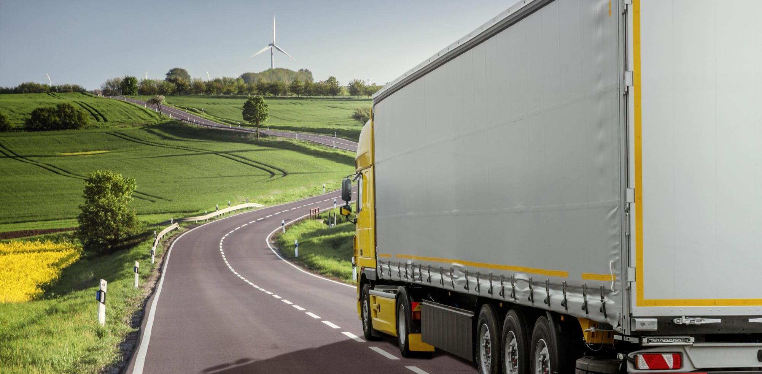
The TRANSP-0 framework for integrated transportation and power system design.
2016 IEEE 19th International Conference on Intelligent Transportation Systems (ITSC 2016), Rio de Janeiro, Brazil, November 1-4, 2016
Dominik Ascher, Technical University of Munich, ascher@in.tum.de
Georg Hackenberg, Technical University of Munich, hackenbe@in.tum.de

Slide 2
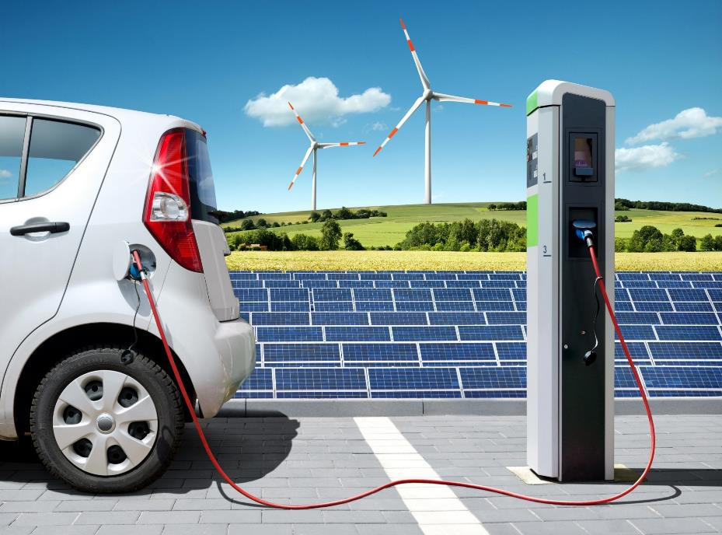
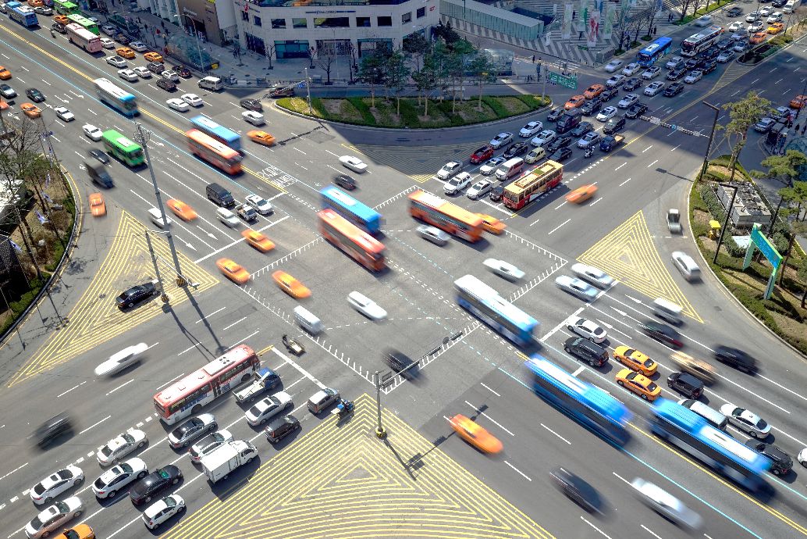


Towards integrated transportation and power system design
Situation and challenges of transportation and power systems.
New energy system dynamics
renewable energy sources,
decentralized power distribution,
prosumers
Smart Energy/Smart Grids
New transportation paradigms
transportation electrification,
mobility-on-demand,
autonomous vehicles
Intelligent Transportation Systems
Power
System
Transportation
System
ITSC 2016, November 1-4, 2016
The TRANSP-0 framework for integrated transportation and power system design
2

Slide 3



Towards integrated transportation and power system design
Why integrate transportation and power systems?
Power and transportation systems are subject to dynamics of supply and demand (as loads/locomotion)
(Cost of) power/transportation supply can be dependent on each other (e.g. with electric vehicles)
Challenge of balancing aligned demands of transportation and power systems (e.g. V2G)
Increased dependencies and demands for information, connectivity and communication between transportation and power systems
Integration of transportation and power systems could help minimize environmental impacts, resource consumption and operation costs as well as maximize long-term sustainability
Need for integrated planning, operation and control strategies.
However: Suitable approaches have yet to be established!
ITSC 2016, November 1-4, 2016
The TRANSP-0 framework for integrated transportation and power system design
3

Slide 4



Towards integrated transportation and power system design
Related work: Existing approaches and models
Intelligent Scheduling
Vehicle Routing
Modeling and Simulation
Intelligent scheduling approaches address control strategies for EV within the power system, but neglect effects on the transportation system,
Vehicle routing approaches provide sufficient representation of the transportation system, but lack details about the power system, in particular electric devices,
Approaches for modeling and simulation employ prescribed control strategies, which do not sufficiently address wide variety of transportation and power system objectives and constraints and their relative impacts.
Modeling of mesoscopic behavior and interactions of both transportation and power systems on the car/electric device level: modeling of integrated systems.
Rapid and flexible adjustment of control strategies (objectives, constraints and behavior within models).
Evaluation of effects of design options with regard to power and transportation infrastructure (e.g. modification of lanes, intersections, etc.)
ITSC 2016, November 1-4, 2016
The TRANSP-0 framework for integrated transportation and power system design
4

Slide 5
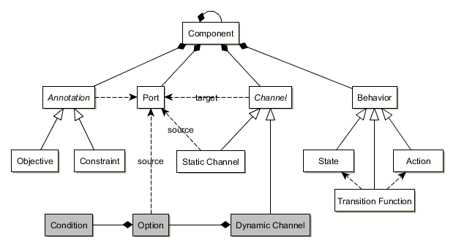
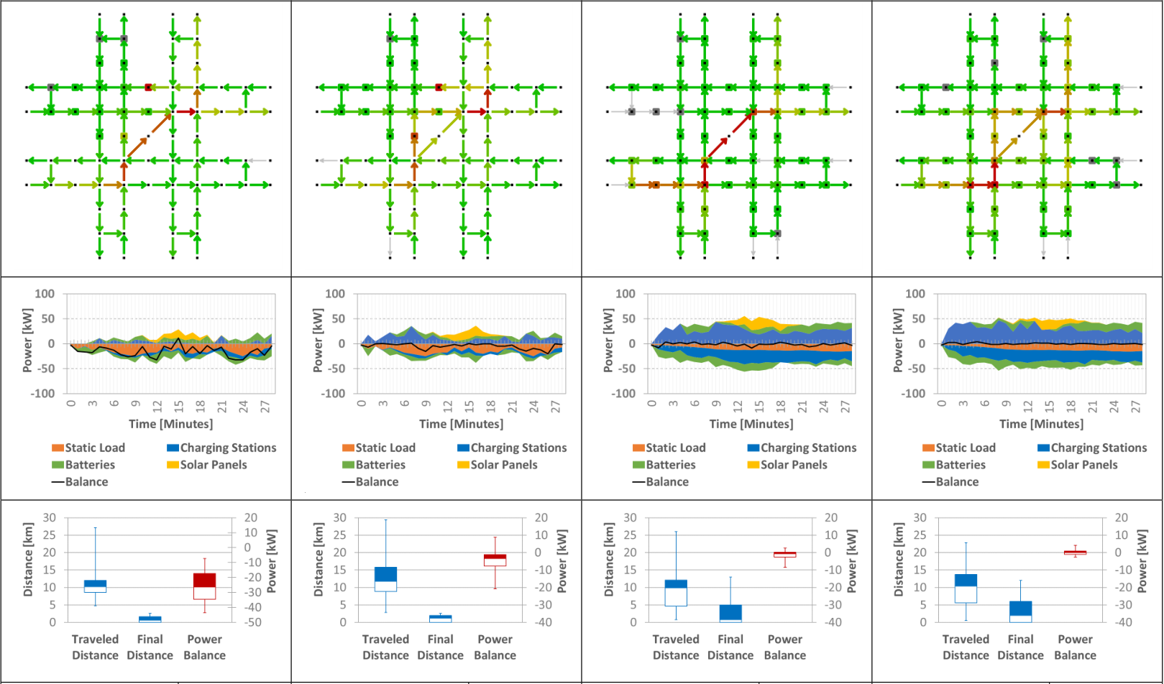
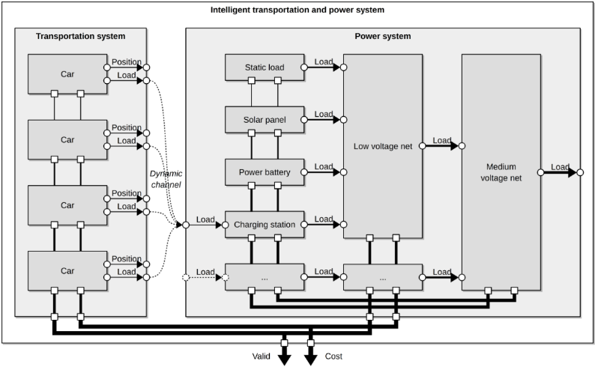

Previous work
Integrated systems modeling technique and demonstration.
Intermediate
Early Estimation of Multi-Objective Traffic Flow
D. Ascher, G. Hackenberg
2014 3rd IEEE International Conference on Connected Vehicles and Expo (ICCVE)
Integrated transportation and power system modeling
D. Ascher, G. Hackenberg
2015 4th IEEE International Conference on Connected Vehicles and Expo (ICCVE)
ITSC 2016, November 1-4, 2016
The TRANSP-0 framework for integrated transportation and power system design
5

Slide 6



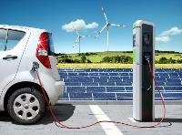

The TRANSP-0 framework for integrated transportation and power system design
The TRANSP-0 system design abstraction.
TRANSP-0 provides a design abstraction for integrated system design for designing static and dynamic properties and control strategies.
Parameters
(Static Properties)
Component Behavior
(Dynamic Properties)
Requirements
(Control Strategy)
Electric Infrastructure
Electric device components
States, actions and transition functions of net regions
Global objectives
(e.g. load balancing, demand response)
Local objectives
(e.g. energy-efficiency)
Constraints (e.g. net capacity)
States, actions and transition functions of electric devices
Power
System
Traffic Infrastructure
Vehicle components
No modeling of dynamic/runtime effects of traffic infrastructure
States, actions and transition functions of vehicles
Global objectives
(e.g. congestion management)
Local objectives
(e.g. shortest traveling time, energy-efficiency)
Constraints (e.g. lane capacity)
Transportation System
ITSC 2016, November 1-4, 2016
The TRANSP-0 framework for integrated transportation and power system design
6

Slide 7
Static design parameters
The subsystem design space
Power System PS = (EI, EC)
Charging Stations CS (Labels, Efficiencies, Positions, Parent Regions)
Static Loads SL
(Labels, Profiles, Parent Regions)
Electric device components EC
= (CS, ES, SL)
Regions R
(Labels, Capacities, Efficiencies, Parent Regions)
Electric Infrastructure EI
= (R)
Electric device components EC
= (CS, ES, SL)
Energy Storages ES
(Labels, Capacities, Efficiencies, Initial SOC, Parent Regions)
ITSC 2016, November 1-4, 2016
The TRANSP-0 framework for integrated transportation and power system design
7

Slide 8
Static design parameters
The subsystem design space
Transportation System TS = (TI, TP)
Intersections I (Labels, Coordinates)
Segments S
(Labels, Source, Target, Capacities, Efficiency)
Traffic Infrastructure TI = (I, S)
Vehicles V
(Labels, Sizes, Mechanical Efficiencies, Electrical Efficiencies, Initial Positions, Battery Capacities, Initial SOC)
Demands D
(Vehicle Labels, Destinations, Time Points)
Traffic participants TP = (V, D)
ITSC 2016, November 1-4, 2016
The TRANSP-0 framework for integrated transportation and power system design
8

Slide 9
Dynamic system design
States, actions and transition functions of an optimal control problem.
ITSC 2016, November 1-4, 2016
The TRANSP-0 framework for integrated transportation and power system design
9

Slide 10
Dynamic system design
Decomposition of states, actions and transition functions.
ITSC 2016, November 1-4, 2016
The TRANSP-0 framework for integrated transportation and power system design
10

Slide 11
Requirements of control strategies
Constraints or objectives control strategies have to satisfy.
Definition of individual control strategies in terms of objectives and constraints of the optimal control problem.
Control strategy determines the actions taken in order to achieve trajectory of states with highest contribution towards specified objectives.
Control strategy limits state evolution to valid behavior.
ITSC 2016, November 1-4, 2016
The TRANSP-0 framework for integrated transportation and power system design
11
Notes:
it

Slide 12
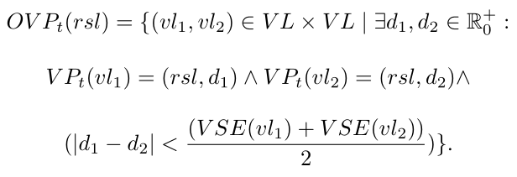
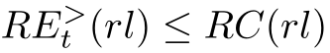
Requirements of control strategies
Applied examples: segment capacity and region capacity constraints.
Segment capacity constraint
Region capacity constraint
(1)
(aggregate production does not exceed region capacity), and
(2)
(aggregate consumption including the losses over power lines does not exceed region capacity)
ITSC 2016, November 1-4, 2016
The TRANSP-0 framework for integrated transportation and power system design
12

Slide 13
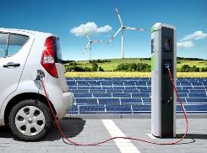
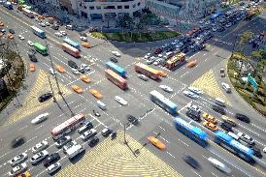
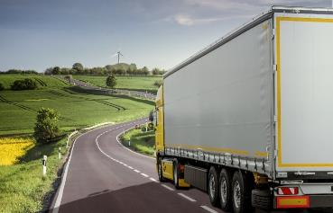

Conclusion and outlook.
Towards integrated transportation and power system design.
Conclusion
Currently available approaches do not comprehensively address demands within integrated transportation and power systems
Development of a design framework to assess planning, operation and control strategies for integrated transportation and power systems
Outlook
Assessment of model validity
Consideration of multi-modality: cars, trains, airplanes, ships, etc.
Adaption to both passenger transportation and logistics problems
Supply-chain wide integration/control strategies
Extension with additional requirements
Power Domain
Transportation Domain
Logistics Domain
ITSC 2016, November 1-4, 2016
The TRANSP-0 framework for integrated transportation and power system design
13

Slide 14
The TRANSP-0 framework for integrated transportation and power system design.
2016 IEEE 19th International Conference on Intelligent Transportation Systems (ITSC 2016), Rio de Janeiro, Brazil, November 1-4, 2016
Dominik Ascher, Technical University of Munich, ascher@in.tum.de
Georg Hackenberg, Technical University of Munich, hackenbe@in.tum.de

Slide 15


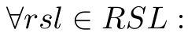
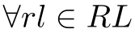
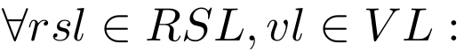
Requirements of control strategies
Constraints or objectives control strategies have to satisfy.
Segment capacity constraint
The Collision property mapping
with Boolean set then cal calculates for each road segment whether a collision occurred in State St or not such that
Ensure that no collisions occur between vehicles vl by calculating for each road segment rsl the pairs of overlapping vehicles
such that
A state is then collision-free if for all road segments
the collision property is false.
Region capacity constraint
Ensure that energy flow RE through each region rl does not exceed its capacity limit, i.e.
(vehicles must reside on same road segment and their half-sizes must be larger than their center distances).
(1)
Then calculate set of overlapping vehicle pairs
with power set
such that
(aggregate production does not exceed region capacity), and
(2)
(aggregate consumption including the losses over power lines does not exceed region capacity)
ITSC 2016, November 1-4, 2016
The TRANSP-0 framework for integrated transportation and power system design
15

Slide 16
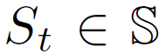
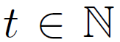
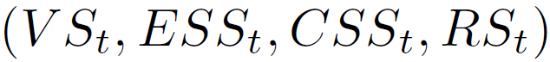
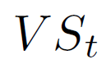
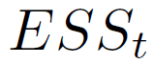
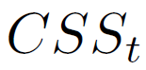
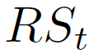

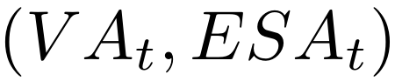
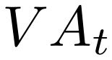
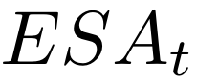


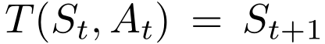
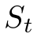
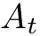
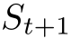
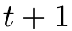
Dynamic system design
States, actions and transition functions of an optimal control problem.
States
The overall system states with time point
of the optimal control problem are modeled as
four-tuple where
represents the vehicle states,
represents the energy storage states,
represents the charging station states, and
represents the region states.
Actions
The actions with time point of the
optimal control problem are modeled as
tuple , where
represents the vehicle actions, and
represents the energy storage actions.
Transition Functions
The transition function of the optimal control
problem is modeled as a deterministic mapping
with transitions
and time point , where
represents the system state at time point ,
represents the action applied to state , and
represents the system state at time point
ITSC 2016, November 1-4, 2016
The TRANSP-0 framework for integrated transportation and power system design
16

Slide 17
Static design parameters
The subsystem design space
Power System PS = (EI, EC)
Transportation System TS = (TI, TP)
Electric Infrastructure EI consisted of
Regions R (Labels, Capacities, Efficiencies, Parent Regions)
Electric device components EC, consisted of
Static Loads SL (Labels, Profiles, Parent Regions)
Energy Storages ES (Labels, Capacities, Efficiencies, Intial SOC, Parent Regions)
Charging Stations CS (Labels, Efficiencies, Positions, Parent Regions)
Traffic Infrastructure TI consisted of
Intersections I (Labels, Coordinates)
Segments S (Labels, Source, Target, Capacities, Efficiency)
Traffic participants TP consisted of
Vehicles V (Labels, Sizes, Mechanical Efficiencies, Electrical Efficiencies, Initial Positions, Battery Capacities, Initial SOC)
Demands D (Vehicle Labels, Destinations, Time Points)
ITSC 2016, November 1-4, 2016
The TRANSP-0 framework for integrated transportation and power system design
17

Slide 18

Demonstration
Iterative evaluation of different V2G scenarios.
Demonstration of 4 incremental small-scale V2G scenarios with varying objective focus and stage of expansion.
Scenario 1
Scenario 2
Scenario 3
Scenario 4
Transportation System
Low
Power System
Low
Transportation System
High
Power System
High
Objective Focus
Concerns
impact of the costs of the transportation system,
impact of the costs of the power system.
C(IS) = w(TS)*C(TS) + w(PS)*C(PS)
Intermediate
Stage of Expansion
Concerns
number of charging stations,
solar panel capacities,
power battery capacities,
static load profile.
ITSC 2016, November 1-4, 2016
The TRANSP-0 framework for integrated transportation and power system design
18

Slide 19
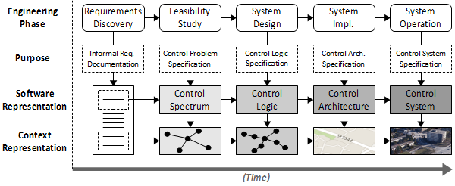
Systems modeling technique
How can we address integration between systems?
Mesoscopic modeling of integrated systems with interactions between components based on ports and channels.
Modeling framework for planning, operation and control problems for integrated transportation and power systems
Interpretation of according design problems as optimal control problems
Systems Engineering Process
Meta-model of the integrated approach.
ITSC 2016, November 1-4, 2016
The TRANSP-0 framework for integrated transportation and power system design
19

Slide 20

Overview of the system model
Channels, Components, Ports
ITSC 2016, November 1-4, 2016
The TRANSP-0 framework for integrated transportation and power system design
20

Slide 21
Previous work
Early Estimation of Multi-Objective Traffic Flow
D. Ascher, G. Hackenberg
2014 3rd IEEE International Conference on Connected Vehicles and Expo (ICCVE)
Integrated transportation and power system modeling
D. Ascher, G. Hackenberg
2015 4th IEEE International Conference on Connected Vehicles and Expo (ICCVE)
The TRANSP-0 framework for integrated transportation and power system design
D. Ascher, G. Hackenberg
2016 19th IEEE International Conference on Intelligent Transportation Systems (ITSC)
An overview.
Multi-Objective Traffic Modeling Technique
Integrated Systems Modeling Technique
Formal Design Framework
ITSC 2016, November 1-4, 2016
The TRANSP-0 framework for integrated transportation and power system design
21

